Slide 1
STEP-PARENT ADOPTIONS IN NEW MEXICO
NMSA 1978 Chapter 32A Article 5 – Children’s Code

Slide 2

Presented by: Ellice Goldstein, Paralegal
Adoptions: Purpose
32A-5-2. Purpose.
The purpose of the Adoption Act is to:
A. establish procedures to effect a legal relationship between a parent and adopted child that is identical to that of a parent and biological child;
B. provide for family relationships that will give the adopted child protection and economic security and that will enable the child to develop physically, mentally and emotionally to the maximum extent possible; and
C. ensure due process protections.
Notes:
NOTE: To change images on this slide, select a picture and delete it. Then click the Insert Picture icon in the placeholder to insert your own image.

Slide 3


NMSA 32A-5-3 Definitions
Adoptee: person who is the subject of an adoption petition
Notes:
NOTE: To change images on this slide, select a picture and delete it. Then click the Insert Picture icon in the placeholder to insert your own image.

Slide 4



Pre-Placement Study NMSA 32A-5-14 Post-Placement Report NMSA 32A-5-31 Step-Parent Adoption NMSA 32A-5-32
Notes:
NOTE: To change images on this slide, select a picture and delete it. Then click the Insert Picture icon in the placeholder to insert your own image.

Slide 5





Federal Indian Child Welfare Act of 1978
Notes:
NOTE: To change images on this slide, select a picture and delete it. Then click the Insert Picture icon in the placeholder to insert your own image.

Slide 6
What needs to go in the Petition?
NMSA 32A-5-26 Petition; content

Slide 7
Petition; Content
A Petition for adoption shall be filed and verified by the petitioner and shall allege:
Full name, age, place and length of resident, marital status, any prior marriages
Date and place of birth of adoptee
Places the adoptee has lived
Birth name of adoptee
Where adoptee is residing at the time of the Petition
The petitioner’s desire to establish a parent child relationship
Existence of any court orders, placement orders that regulate custody and visitation of adoptee
Relationship, if any to adoptee

Slide 8
Petition; Content
Name and address of placing agency, if any
Names and addresses of all persons from whom consents or relinquishments are required
If the adoption is an open adoption
If child’s father’s consent is alleged to be unnecessary, if the putative father registry has been searched
If the child is an Indian child
If the adoption is subject to the Interstate Compact on the Placement of Children
If the adoptee is foreign-born

Slide 9
NMSA 32A-5-32 STEPPARENT ADOPTIONS
A. Any person may adopt his spouse’s child in accordance with the provisions of the Adoption Act.
B. When the adoptee has lived with his stepparent for at least one year following the stepparent’s marriage to the custodial parent:
(1) placement shall not be required pursuant to Section 32A-5-12 NMSA 1978;
(2) a pre-placement study or post-placement report shall not be required unless ordered by the Court;
(3) when the stepparent and the custodial parent have been married for less than two years, counseling shall be required for the stepparent and the custodial parent;
(4) the noncustodial parent shall receive counseling unless counseling is waived;
(5) the adoptee, if ten years of age or older, shall receive counseling;
(6) a criminal records check shall be conducted on a stepparent pursuant to Section 32A-5-14 NMSA 1978

Slide 10
NMSA 32A-5-32 STEPPARENT ADOPTIONS
(7) a report of fees and charges shall not be prepared, unless ordered by the court pursuant to Section 32A-5-34 NMSA 1978;
(8) the court may waive the ninety-day period between filing of the petition for adoption and issuance of the decree of adoption; and
(9) when adopted, the adoptee shall take the name designated in the adoption petition, so long as the petitioner’s spouse and the adoptee, if ten years of age or older, consent to the name.
C. When an adoptee has not lived with the stepparent for more than one year following the stepparent’s marriage to the custodial parent, the adoption shall proceed as an independent adoption;

Slide 11
NMSA 32A-15-14.1 Criminal History Records Check; background checks
A. A nationwide criminal history records check shall be conducted on a person who files a petition to adopt a child, on prospective foster parents and on other adults residing in the prospective adoptive or foster parents. The department is authorized to use the set of fingerprints to conduct a background check of the person providing the fingerprints by submitting the fingerprints to the department of public safety and the FBI
B. Criminal history records obtained by the department pursuant to the provisions of this section are confidential. Criminal history records obtained pursuant to the provisions of this section shall not be used for any purpose other than conducting background checks. Criminal history records obtained pursuant to the provisions of this section and the information contained in those records shall not be released or disclosed to any other person or agency, except pursuant to a court order or with the written consent of the person who is the subject of the records.

Slide 12
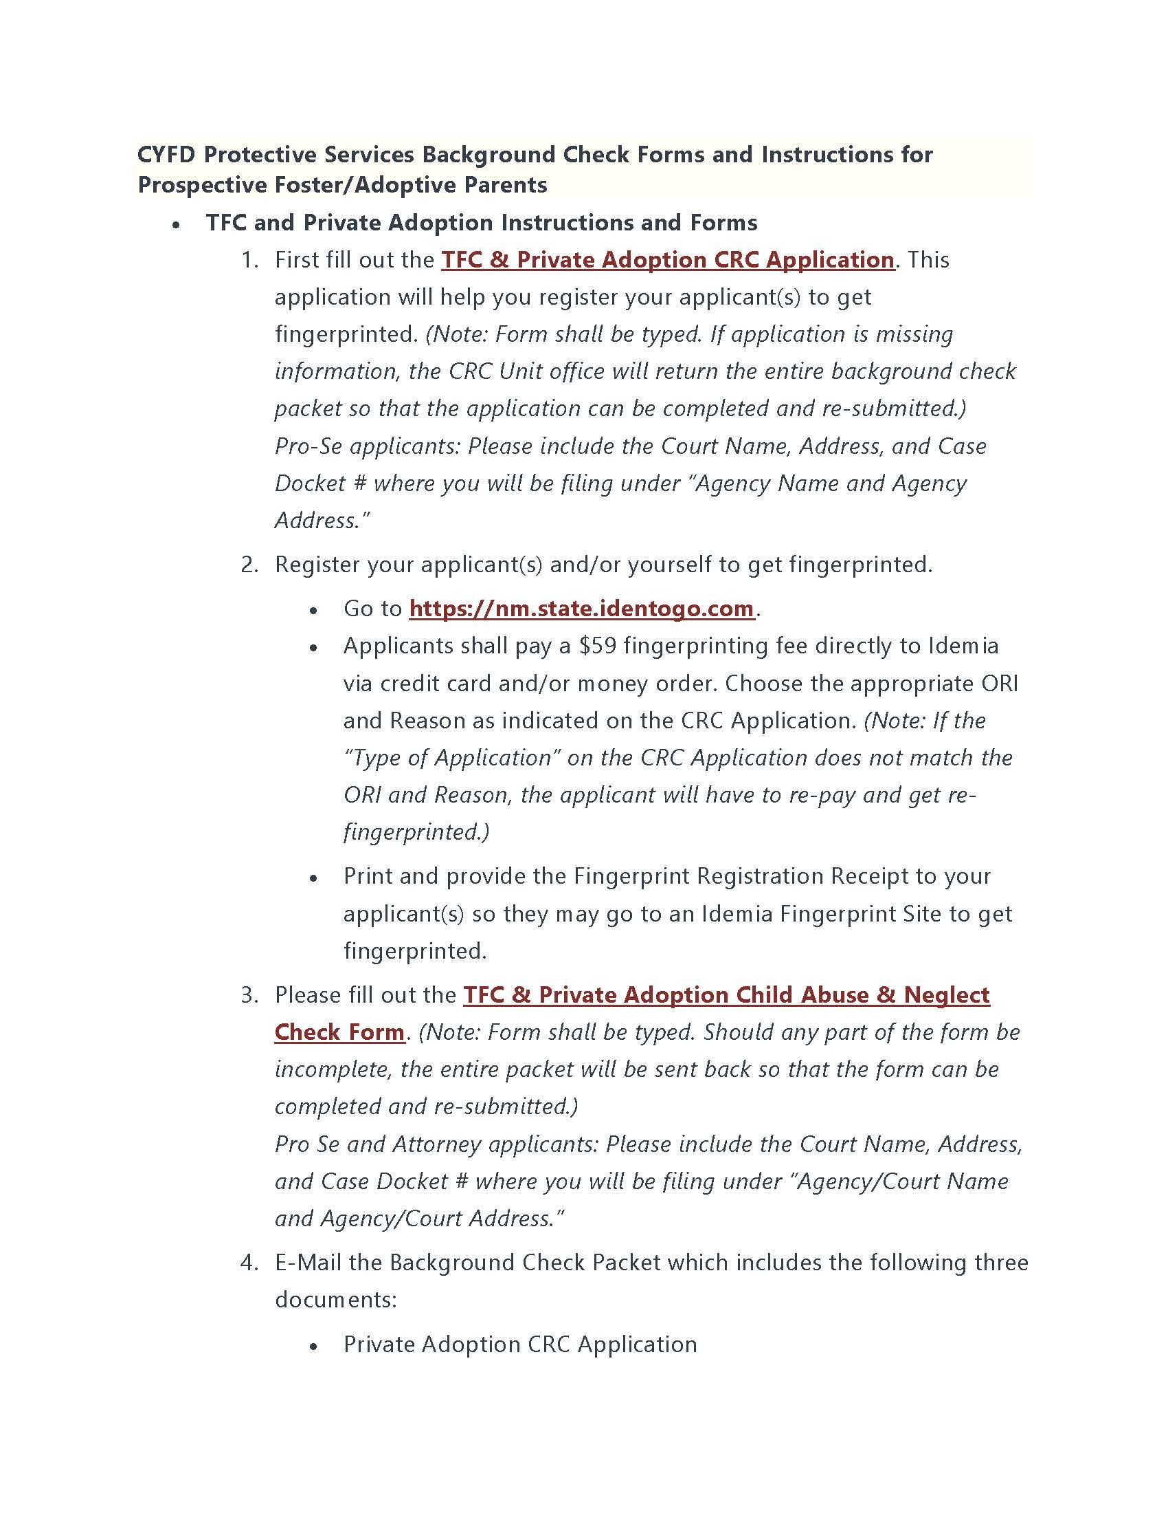
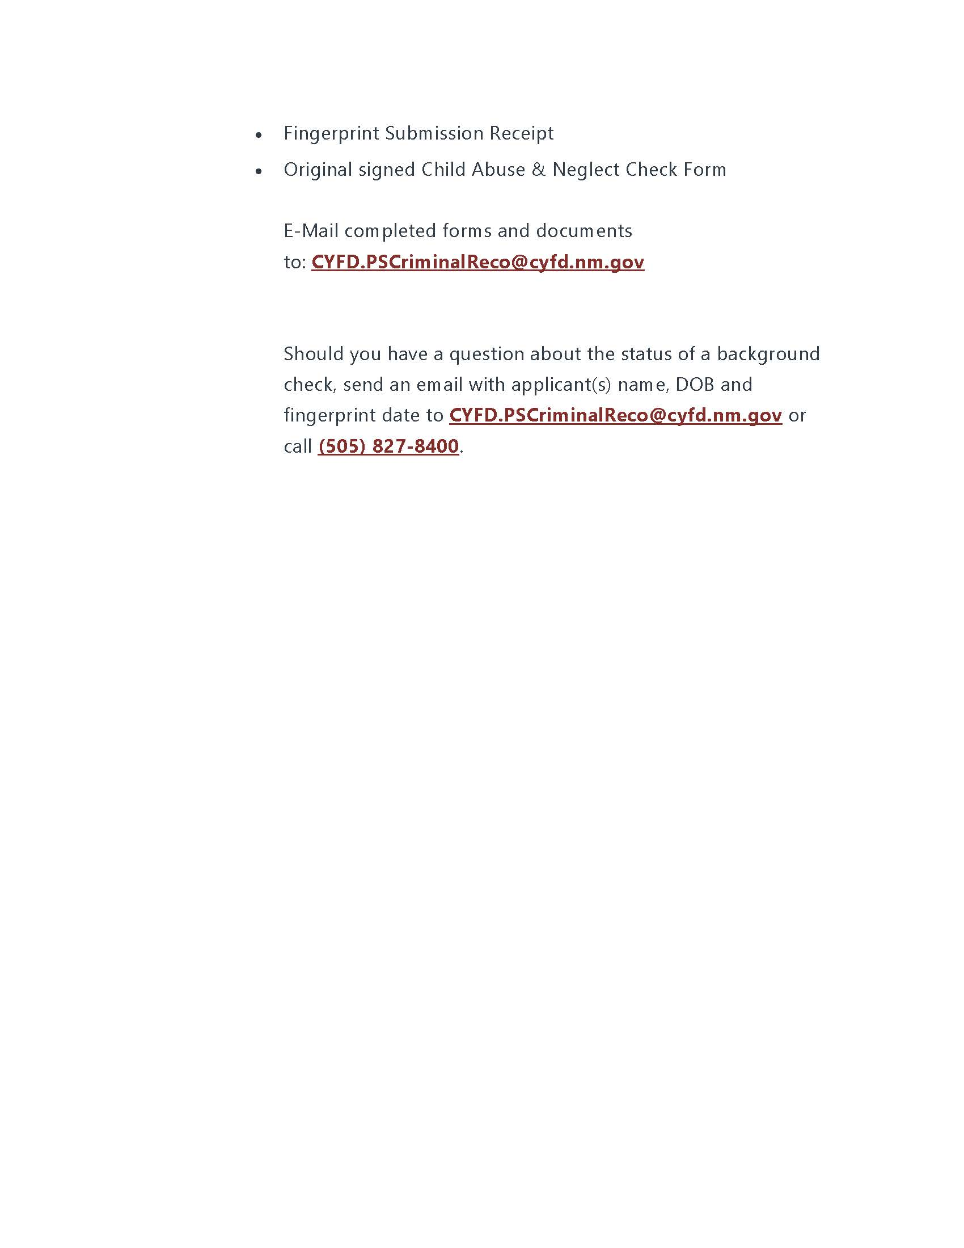
CYFD Forms

Slide 13
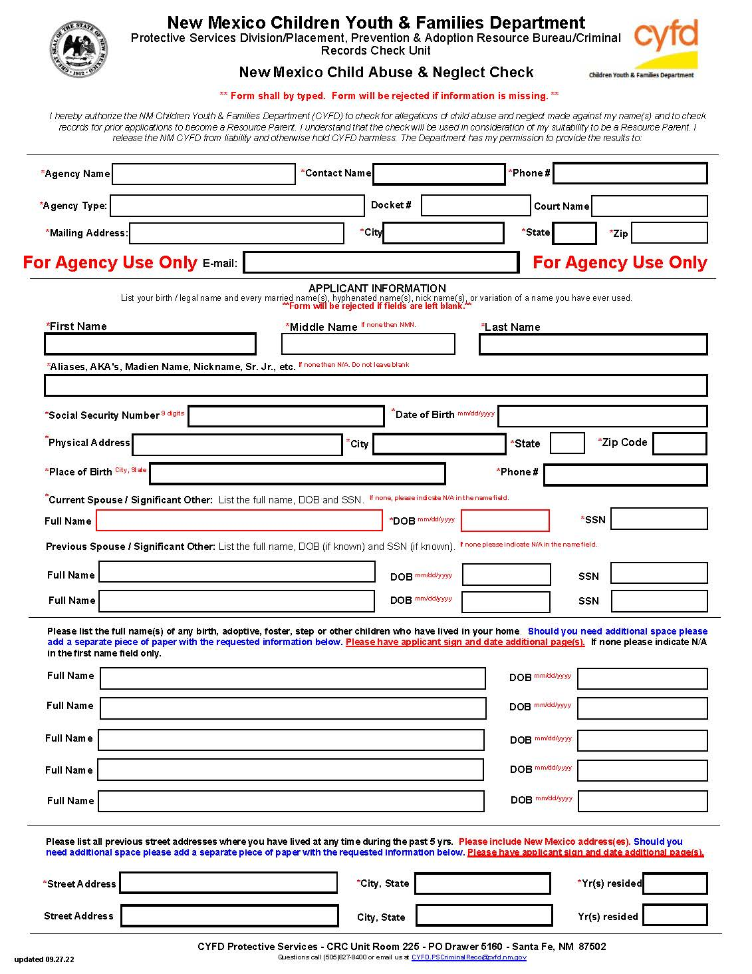
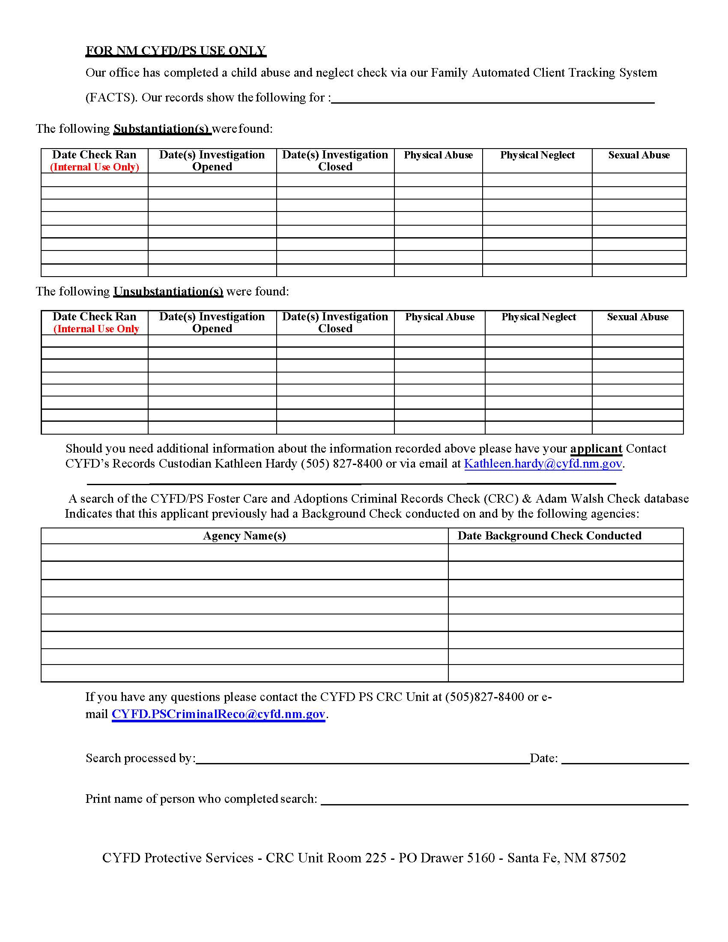
CYFD Abuse and Neglect Check

Slide 14
CYFD CRC FORM (CRIMINAL RECORDS CHECK)

Slide 15
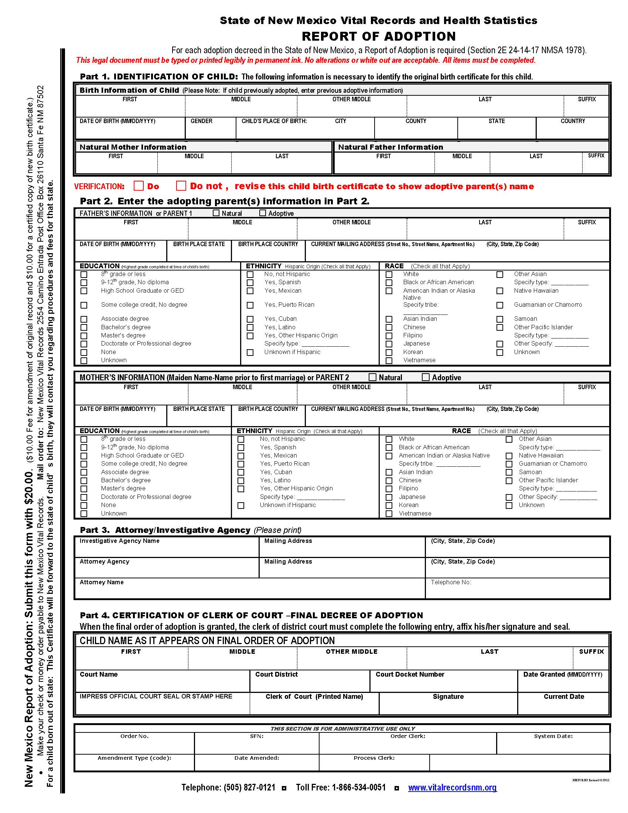
FINAL REPORT OF ADOPTION

Slide 16


QUESTIONS?

