Slide 1



Child Support Services Division (CSSD)
Notes:
Record!
Ask people to say hello in Chat and where they are joining from!

Slide 2
YOU THOUGHT YOU KNEW EVERYTHING ABOUT CHILD SUPPORT
MAY 2 , 2026
Presented by: Larry Heyeck
CSSD Regional Managing Attorney

Slide 3

BEFORE WE START...
On behalf of all colleagues at the Health Care Authority, we humbly acknowledge we are on the ancestral lands of the original peoples of the Pueblo, Apache, and Diné past, present, and future.
With gratitude we pay our respects to the land, the people and the communities that contribute to what today is known as the Great State of New Mexico.
Learn more: About Taos Pueblo at Taospueblo.com
A cloudy morning looking over Taos Pueblo
Photo provided by elpueblolodge.com
Notes:
Alex

Slide 4
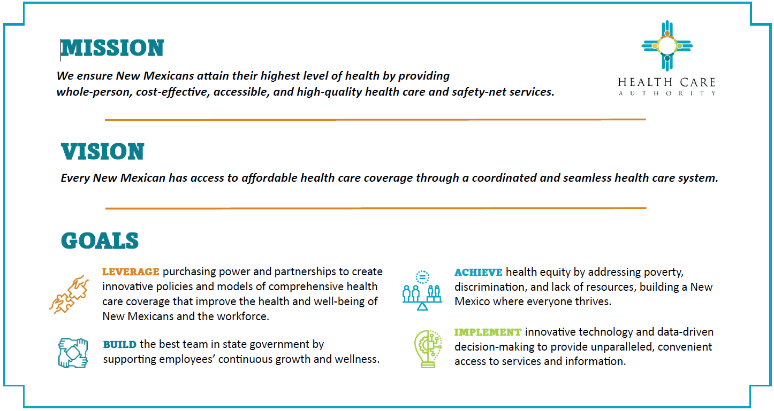

Slide 5
WHAT IS CHILD SUPPORT?
Child support is a court-ordered payment from one parent to another to help cover the costs of raising a child(ren).
Primary custody (worksheet A) vs. Shared responsibility (worksheet B)
§ 40-4-11.1 (2023) – Child Support Guidelines Statute
“shared responsibility” – thirty-five percent (35%) of the year in each home
# of 24-hour days of responsibility that each parent has each child in a year
CSSD uses “overnights” – must be more than 127.75 (365 x 35% = 127.75)

Slide 6
THE CHILD SUPPORT GUIDELINES § 40-4-11.1 (2023)
Found under the Dissolution of Marriage Statutes
NMUPA specifically references the statute to determine child support - § 40-11A-636(I) (2021)
Creates confusion regarding retroactive child support
Can a married parent obtain retroactive child support from the date of separation?
See, Paper: https://www.sbnm.org/Leadership/Sections/Family-Law/Articles-Publications
Guidelines create a presumption of the proper financial support for the child(ren), § 40-4-11.1(A) (1993); Leeder v. Leeder, 1994-NMCA-105, ¶ 6. This presumption is “rebuttable”. Klinksiek v. Klinksiek, 2005-NMCA-008, ¶¶ 7, 10. The court is required to first determine “gross income” Id.
NOTE: tribunal has discretion in setting child support, Spingola v. Spingola, 1978-NMSC-045, ¶ 19; this discretion must be exercised in accordance with the guidelines, Tedford v. Gregory, 1998-NMCA-067, ¶¶ 32-33. Tribunal is required to explain how child support was calculated. Id., ¶ 31.

Slide 7
CHILD SUPPORT GUIDELINES
The guidelines were revised and modified in 1991, 1995, 2008, 2021, and 2023
The 2008 guidelines do not have a formula for calculating the child support obligation for high income parties. The 2014 New Mexico Guidelines Commission Report noted that the $30,000 combined gross income was NOT meant to be a cap and recommended to the Legislature that it carry over the prior years’ formula. It was not proposed.
Jury v. Jury, 2017-NMCA-036, ¶ 43, and n.2, uses historical reference (11% for one child; 16.1% for two children; 18.8% for three children).

Slide 8
GROSS INCOME
“Gross income” includes income from any source . . . .” § 40-4-11.1 (2023) – broad interpretation, See, e.g., In re Marriage of Branch, 152 P.3d 1265 (2007) (gross income includes every conceivable form of income, excluding public assistance and child support received for other children of the parents).
Rental payments – all the rental payments are included, however, can exclude expenses for repairs, property management and leasing fees, real estate taxes, and insurance. Klinksiek v. Klinksiek, 2005-NMCA-008, ¶ 9. Rental income that reduces the mortgage indebtedness while increasing equity are not “necessary and ordinary” expenses (payment on the principal). Id.

Slide 9
SETTLEMENTS
Settlement proceeds is not income for child support purposes UNLESS that parent actually withdrew it for his/her own purposes, Webb v. Menix, 2004-NMCA-048, ¶ 30 (citations omitted).
Webb v. Menix – undistributed principal amount from a lump-sum settlement should not be considered income when it is being used to generate the income to pay child support, Webb v. Menix, 2004-NMCA-048, ¶ 35, (such as interest on the principle).
Use date when funds are received and NOT date of injury, Webb v. Menix, 2004-048 (injury occurred 4 years before birth of child); Mower County Human Services, ex rel., Meyer v. Hueman, 543 N.W.2d 682 (Minn.App. 1996) (child would enjoy the standard of living his parent had received had it been an intact household); Butler v. Butler, 488 A.2d 1141 (PA. 1985) (parent’s income is reviewed at the pendency of the child support matter).

Slide 10
BUSINESS EXPENSES
Business Expenses – do not include “artificial” expenses, such as depreciation, EV credit, and capital losses;
Does not include charitable contributions.
See, e.g., Tibor v. Tibor, 623 N.W.2d 13 (N.D. 2001) (a parent’s net income may not include costs based on litigation loans, voluntary life insurance, retirement, and charitable contributions; therefore, may not be included in a parent’s gross income); Friermood v Friermood, 25 S.W.3d 758 (Tex-App – Houston 2000) (chartable contributions should be included as income as parent could have made this income available for child support); “Treatment of Depreciation Expenses Claimed for Tax Accounting Purposes in Determining Ability to Pay Child Support or Spousal Support,” 29 A.L.R.5th 46.

Slide 11
GUARDIANS’ INCOME NOT CONSIDERED
Child Support Guidelines
“The basic child support obligation shall be calculated based on the combined income of both parents and shall be paid in accordance pursuant to Subsection L of this section.” § 41-4-11.1(G)
“children of the parties” means the natural or adopted child or children of the parties to the action before the court but shall not include the natural or adopted child or children of only one of the parties, § 40-4-11.1(F)(1)
Kinship Guardianship
“As part of a judgment entered pursuant to the Kinship Guardianship, the court may order a parent to pay the reasonable costs of support and maintenance of the child that the parent is financially able to pay. The court may use the child support guidelines set forth in Section 40-4-11.1 NMSA 1978 to calculate a reasonable payment.” § 40-108-8(D) (2023)
Kinship Guardianship petition form, a use note says, “[b]oth parents may be ordered to pay child support. The petitioners’ income should not be used for calculation of child support.”
Caselaw
“The non-custodial parent pays the custodial parent a percentage of basic support equal to the non-custodial parent’s share of the combined income” Erickson v. Erickson, 1999-NMCA-056, ¶ 1.
Human Services Department v. Barela, 1994-NMCA-036 (the worksheet has a column for “custodial parent” and “other parent” because a kinship guardian is not listed, their income is not used.
Fevig v. Fevig, 1997-NMSC-005 (parents obligated to pay child support to older daughter caring for her younger sisters).

Slide 12
WHO PAYS CHILD SUPPORT?
Both parents have a duty to financially support their minor child(ren), Chatterjee v. King, 2012-NMSC-133, ¶ 14, Wallis v. Smith, 2001-NMCA-017, ¶ 10
Child support guidelines take into consideration the parties’ respective incomes, Rosen v. Lantis, 1997-NMCA-033, ¶ 8, (“The basic child support obligation is a function of the combined income of the parents and is paid by them in proportion based on their respective incomes and the amount of time each bears responsibility for the child.”) Erickson v. Erickson, 1999-NMCA-056, ¶ 11
“Self-support reserve" means the support calculation ensures the payer parent has sufficient income to maintain a minimum standard of living. The self-support reserve is $1,200 per month for one person which is slightly higher than one hundred percent of the federal poverty guideline. NMAC 8.50.108.7

Slide 13
CHILD NO LONGER LIVING WITH CUSTODIAN
General Statement – parents have a duty to support their children until they reach the age of majority or are otherwise emancipated. Mason v. Mason, 1973-NMSC-031; NMSA 1978, § 40-4-7(B)(3)(a) (1997); § 40-4-11(C) (1988), and §40-4-11.1(B)(1) (2023).
Fevig v Fevig, 1977-NMSC-005, older sister was granted child support from BOTH parents as she never agreed to furnish all monetary support;
Morris v. Powell, 840 S.E.2d 223 (Ct.App.N.C. 2002) (father remained obligated to pay child support after his 17-yr old son had not been legally emancipated)

Slide 14
DEVIATIONS
Governed by NMSA 1978, § 40-4-11.2 (2023)
Requires a written finding and that the child support guidelines would be “unjust and inappropriate.
“A finding that rebuts the child support guidelines and basic child support scheduled shall state the amount of support that would have been required . . . and the justification of why the order varies from the guidelines . . . .” § 40-4-11.2 (2023).
“Circumstances creating a substantial hardship in the obligor, oblige, or subject children may justify a deviation upward or downward from the amount that would otherwise be payable under the guidelines and basic child support schedule.” § 40-4-11.2 (2023).

Slide 15

GENERAL LEGAL PRINCPLES
Child support guidelines are the PRESUMED amount of child support
Court must make FINDINGS to justify the substantial hardshIp
Deviations can be upwards as well as downwards
EXAMPLES – custodial parent caring for a disabled child and having to incur additional expenses to transport child for treatment
Deviations can occur by REBUTTING the presumption

Slide 16
DV ACTIONS/DM ACTIONS
Family Violence Protection Act (FVPA) is designed to provide protection to victims of domestic abuse. Lucero v. Pino, 1997-NMCA-089, ¶ 2. FVPA permits the court to “enter a temporary award of child custody.” Id. “This custody order, however, is limited in duration and is not designated to be a substitute for other proceedings related to child custody.” Id.; § 40-13-5(D) (if another action relating to child custody is pending or has been completed, and initial order under the FVPA may be entered, but the custody matter must then be transferred to the court having jurisdiction over the pending or prior action).
In the DM case, you file a motion, request that the court take judicial notice of the DV order – can seek change of custody and corresponding change in child support

Slide 17
MODIFCATIONS OF CHILD SUPPORT
Must be made “upon a showing of material and substantial changes in circumstances” § 40-4-11.4(A) (2021)
By the court order, Bustos v. Bustos, 2000-NMCA-040, ¶ 15
Date of the filing of the motion dictates the “effective date,” Montoya v. Montoya, 1980-NMSC-122, ¶ 2
Retroactive child support is not permitted, Gomez v. Gomez, 11978-NMSC-093, overruled on other grounds, Montoya v. Montoya, 1980-NMSC-122.
Change of custody, if granted, “implicitly would involve the consideration of future child support,” Corliss v. Corliss, 1976-NMSC-023, ¶ 13.
Better practice is to file a motion to modify child support at the same time or within the same motion for the custody modification, Id.

Slide 18
TWO KINDS OF WAIVER
First kind – waiver consists of a “known legal right, relinquished for consideration, where such legal right is intended for the waiver’s sole benefit and does not infringe on the right of others”
Generally, does not apply in CS cases as the “child” has a separate interest

Slide 19
WAIVER BY ACQUIESCENCE
Waiver by acquiescence may arise “where the evidence shows the existence of an agreement . . . supported by consideration, and where the agreement has been acquiesced in over a period of time under circumstances giving rise to estoppel.”

Slide 20
WAIVER CONTINUED
Waiver cannot “be presumed or implied, contrary to the intention of the party whose rights would be injuriously affected thereby, unless, by his conduct, the opposite party has been misled, to his prejudice, into the honest belief that such waiver was intended to be consented to.”
If no “express agreement,” an “enforceable waiver cannot be inferred unless there are unequivocal acts or conduct showing an intent to waive.”

Slide 21
WAIVER CONTINUED
Waiver by acquiescence “arises when a person knows he is entitled to enforce a right and neglects to do so for such a length of time that under the facts of the case the other party may fairly infer that he has waived or abandoned such right.”

Slide 22
CONSIDERATION
Bargained-for exchange of something of value between parties
Examples – money for something; promise for a promise; or an act; in child support cases, this can include preserving the family unity
What is NOT consideration – a gift; past consideration; preexisting duty

Slide 23
THE STATE’S WAIVER OF ARREARS
Arrears are “assigned” (TANF recovery) and “unassigned” (owed to the custodial parent
The noncustodial parent is required to complete the Arrears Management Program application and, if appropriate, the hardship addendum
Needs approval by the Court

Slide 24
HODGEPODGE
Birth Certificate
The state shall issue a new birth certificate pursuant to NMSA 1978, § 24-14-17 (1993); NMSA 1978, § 40-11A-636F (2023)
Maximum Amount
The maximum amount withheld shall not exceed 50% of the obligor’s income. NMSA 1978, § 40-4A-4.1(E) (1997)
20% of the Delinquency
If there is a delinquency, the additional amount of 20% of the monthly support may be ordered until payment of any delinquency is completed. NMSA 1978, § 40-4A-6(A)(2) (1985)
Reasonableness of Medical Support
Medical cost is considered reasonable in cost if the cost to the parent responsible for providing medical support does not exceed five percent of the parent’s gross income. NMSA 1978, § 40-4C-4(C)(2) (2023)

Slide 25
HODGEPODGE - CONTINUED
AOP (Acknowledgement of Paternity [Parentage])
"acknowledged father" means a man who has established a father-child relationship pursuant to Article 3 of the New Mexico Uniform Parentage Act, NMSA 1978, § 40-11A-102(A) (2009)
Father-child relationship is established by an effective AOP, NMSA 1978, § 40-11A-201(B)(2) (2009)
An AOP shall state that the signatories understand that the acknowledgment is the equivalent of a judicial adjudication of paternity of the child and that a challenge to the acknowledgment is permitted only under limited circumstances and is barred after two years, NMSA 1978, § 40-11A-302(A)(5) (2009)
An AOP is the “equivalent” as an adjudication of paternity, 40-11A-305(A) (2009)
Proceeding for recission of an AOP must be brought within 60 days of the effective date of the AOP, NMSA 1978, 40-11A-307(A) (2009)
HCA/CSSD will not initiate an action to rescind or disestablish parentage, NMAC 8.50.107.8(F).

Slide 26
ADMINISTRATIVE ENFORCEMENT
Income Withholding
In cases involving child support payments, the payments shall be made through CSSD, LR 3-403
CSSD serves as the “bookkeeper”
An Order or Notice to Withhold Income for child support is system generated and served on the payor’s employer
CSSD’s orders state that it is the payor’s responsibility to make the monthly payments until income withholding is in effect or whenever income withholding is not in effect due to self-employment or unemployment
The employer is required to begin deducting child support payments from their employee’s wages or benefits and forward the amount to CSSD.
CSSD works with the New Mexico Department of Labor to withhold child support payments from unemployment benefits that a payor qualifies to receive

Slide 27
ADMIN ENFORCEMENT - CONTINUED
State Tax Refund Setoff
Within 10 days of receiving notification of an offset from the Taxation and Revenue Department (TRD), CSSD will send a notice to the payor’s “last known address” to include: a statement that an offset will be made and that CSSD intends to apply the amount a claimed debt; the amount of the debt asserted; the name, address, and telephone number of the CSSD field office (14 around the state); the amount of refund to be offset against the debt; a statement that the payor has 30 days from the date of the notice to contest the offset by requesting an administrative fair hearing; and a statement that failure to apply for a hearing within the 30 days will be deemed a waiver to contest the offset
After 30 days, the money is applied as a regular payment and distributed first to the on-going child support obligation and then to the arrears
Referrals to TRD are electronically submitted yearly in December
Updates to delete or modify the amount downwards are sent weekly
Arrears will not include fees, court costs, or any other non-child support obligations

Slide 28
ADMIN ENFORCEMENT - CONTINUED
Federal Tax Refund Offset Program
Child support cases may be referred for federal income tax offset regardless of whether the child(ren) are emancipated, so long as there is a delinquent or arrears owed
Cases having spousal support delinquencies or arrears will not be referred if there is not also an on-going child support obligation, delinquency, or arrears
Payment processing only payments are NOT referred
Amount owed exceeds $500
IRS form 8379 – Injured spouse must complete

Slide 29
ADMIN ENFORCEMENT - CONTINUED
Passport Denial Program
OCSE submits the names of payors that owe at least $2,500 in arrears (assigned and unassigned) to the federal Department of State Passport Denial Program
OCSE or the State Department sends out a Pre-Offset Notice to the individual certified for passport denial
CSSD sends a weekly tape to OCSE to certify, modify, or delete individuals who meet or have met the criteria for the Administrative Offset Program, which includes Passport Denial
Applies to original passports, passport renewals, additional pages, change of name on a passport, a passport picture, or repairing a passport to individuals listed on the OCSE certified report
Military – also applies to deployed individuals – they will be restricted to base

Slide 30
ADMIN ENFORCEMENT - CONTINUED
Financial Institution Data Match (FIDM)
FIDM is an automated process based on arrears owed
Payor’s pending insurance claims can also be matched (e.g., workers’ compensation, personal injury, property damage claims)
Initial Screening
If the payor owes an equivalent of at least two full months of support a referral is made
If the account balance is less than $1,500, FIDM staff will not refer the case
Insurance claims – if the FIDM match is from a pending insurance claim, FIDM staff will initiate the lien process by sending a Lien Fact Sheet
Payor does not receive advance notice of a free – a “FIDM Freeze Letter” is sent to the payor 7 days after receiving notice of the freeze from the financial institution
The freeze includes all accounts with the payor’s name, regardless if it is a joint account
It can take up to a week to release funds

Slide 31
ADMIN ENFORCEMENT - CONTINUED
Credit Bureau Reporting
Referrals are made from CSES (CSSD’s case management system) monthly – includes the name of the obligor, that the obligor has been sent a notice of potential submittal, and that the 30-day “due process period” has elapsed
Changes to cases that impact credit bureau reporting will be reflected in the monthly transmittal
Cases closed within the month are included in the monthly transmittal
Credit bureaus maintain the information reported in the month of closure for 7 years

Slide 32
ADMIN ENFORCEMENT - CONTINUED
Liens
Child support order “becomes a lien on the real and personal property of the obligor from the date of a notice of order or decree in the office of the county clerk of each county where any property may be situated, NMSA 1978, § 40-4-15(A) (2011)
Release of Lien
CSSD only issues certificates of release for those orders recorded and monitored by CSSD
Information that is needed
A written request
If the request is not from the obligor, an authorization to release information to the individual or company signed by the obligor or other party involved in the support order
A copy of the recorded documents that created the lien. This should include the document number and the filing date
Companies that are requesting a certificate of release on behalf of an obligor may include a lien statement or report to ensure that all liens which need to be released are provided and to confirm the recordation number and date of recording when faxed information is not clear

Slide 33
ADMIN ENFORCEMENT - CONTINUED
License Suspension Process
NOTE: CSSD does not suspend licenses. CSSD submits a certified list of delinquent obligors to the appropriate boards, commissions, courts, or agencies responsible for issuing drivers, professional, occupational, and recreational licenses.
License suspension process will start even if the obligor is making partial payments
CSSD sends a letter to obligor giving the obligor 30 days to respond and resolve the delinquent amount. This letter is system generated and automatically sent. During this period, CSSD can work with the obligor to stop the license suspension process. For driver’s license:
If obligor fails to respond or bring the balance down, the referral is made to Motor Vehicle
MVD sends obligor its letter with a second 30-day timeframe to request a hearing with MVD. If no response, the driver’s license is suspended
Issuance of a “certificate of compliance (COC)”

Slide 34


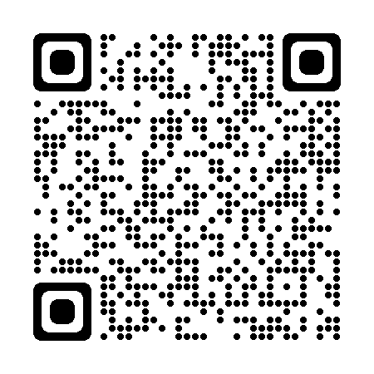


CONVENIENCE AT YOUR FINGERTIPS
View and manage child support cases
Make an online payment or view payment status
Access the eLink Employer site
Address
Central office
PO Box 2348
Santa Fe, NM 87504
Fax # 505-476-7045
CUSTOMER SERVICE LINE
1-800-283-4465
FOR ONLINE SERVICES
HTTP://YES.NM.GOV
To email your worker:
Child.support@hca.nm.gov
https://yes.nm.gov/
CHILD SUPPORT
New Mexico Child Support helps parents care for their children. Services are available for parents or guardians that receive child support and for those that are obligated to pay child support.
Notes:
Betina

Slide 35
QUESTIONS

